Slide 1
INDOOR
AIR POLLUTION
DATE: 5 -11 -fi 0 fi fi
ProjectSixty Percent
ABHINAV REDDY | 2021101034
ROHIT GOWLAPALLI | 2021101113
GNANA PRAKASH | 2021111027
LSA MOURYA | 2021101121

Slide 2
Every year, 3.8 million people die from indoor air pollution.
MOTIVATION
S o u r c e : W o r l d H e a l t h O r g a n i z a t i o n
CAUSES
SOLID COOKING FUELS COOLING SYSTEMS
EFFECTS
PREMATURE DEATHS
HEART DISEASES AND CANCER
Necessity is the Mother of Invention

Slide 3

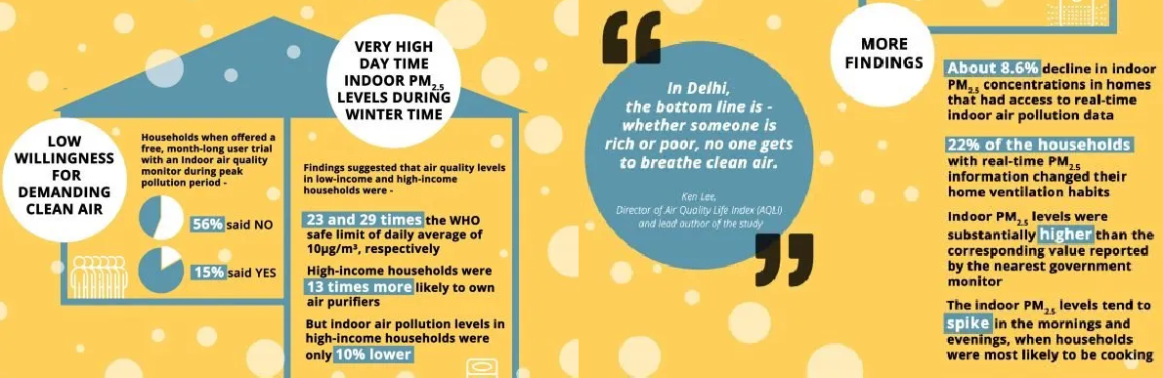

Indoor Air Quality Statistics in
Source: https://epic.uchicago.in/delhi-homes-record-poor-indoor-air-quality-low- willingness-for-demanding-clean-air/

Slide 4
Permissible Limits of Air Pollutants
CARBON DIOXIDE
VOLATILE ORGANIC COMPOUNDS
INDEX
PARTICULATE MATTER
PM 2.5 PM 10
< 50 µg/m³ < 50 µg/m³
Low:
> 250 ppm
Low:
0 - 100
Low:
Medium: 101 - 200
High: 200 - 500
50-150
µg/m³
Medium: > 1000 ppm
High: > 2000 ppm
Medium: ⁵⁰⁻¹⁵⁰
µg/m³
High:
> 150 µg/m³ > 150 µg/m³

Slide 5



Hardware
Overview
Our Smart IoT-device calculates the levels of various air pollutants such as CO2, particulate matter of sizes 2.5 & 10 microns , VOCs and also measures Heat Index by keeping track of Temperature and Humidity.
ESP32
DHT11/SHT4X sensor Prana-Air CO2 sensor Prana-Air PM sensor PCBs
Power Source
Software
Arduino
ThingSpeak + OM2M Python
React JS + Tailwind CSS
Node JS + MongoDB + Express JS

Slide 6
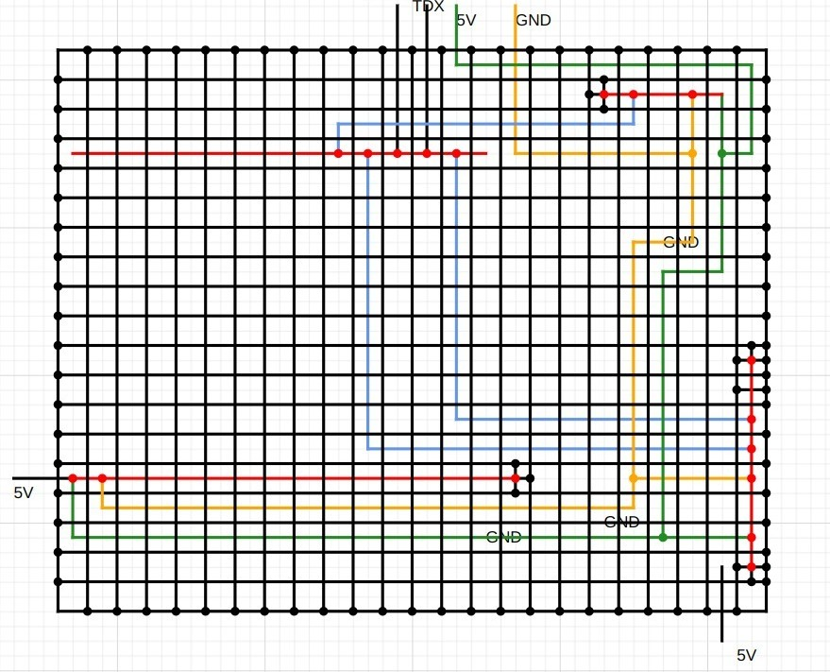
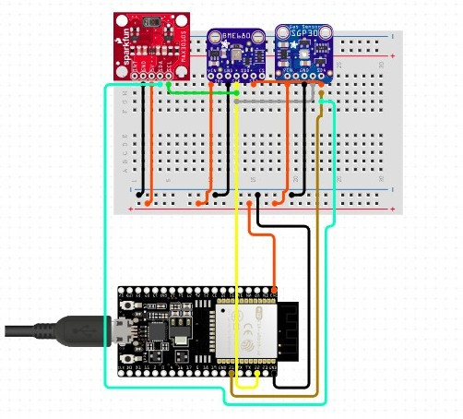

PCB DIAGRAM
CIRCUIT DIAGRAM
Sensors used:
Prana Air NDIR CO2 Sensor
SGP40 Sensor (VOC, Temp, Humidity) Prana Air SDS Sensor (PM2.5 and PM10)

Slide 7


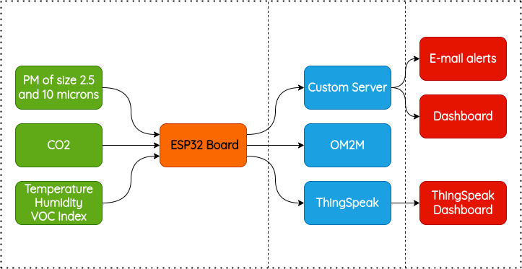



Flow of Information

Slide 8



Project Flow
3
User Experience
Dashboard shows safety levels according to air quality levels
Emails will be sent when air
quality degrades drastically
1 Onsite Implementation
Wireless node connected to server Measure quantities like:
Temperature and Humidity
CO2 levels
VOC levels Particulate matter
Collected data sent to server
Data Handling
Data obtained posted to: ThingSpeak
OM2M
Server
ThingSpeak gives pictorial
2
representation
OM2M and Server show real-time data

Slide 9

Data Processing
Calibration
Improper data samples can be ingested since sensors can have different sets of calibration points. To overcome this, we are planning to use Linear Regression to train our project with data samples
Outlier Detection
Routines like Z-score/IQR/boxplot are employed to identify samples that do not fit the expected data distribution.
Validation & Prediction
Linear Regression through pre-calibrated sensor is employed for validation of the obtained data samples and can ultimately be used to predict future data

Slide 10
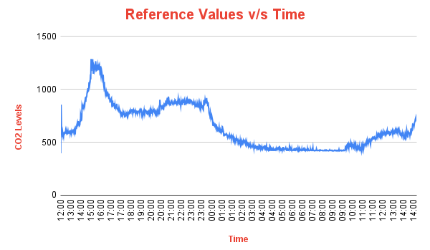

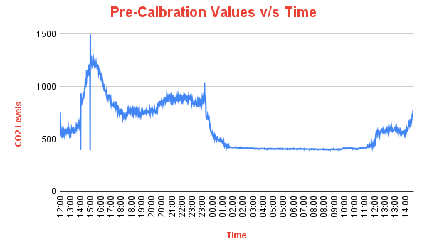
Calibration
Proper Sensor Calibration yields accurate measurements
Machine Learning
ML is employed to map reference data (used as training data) to experimental data
Linear Regression
LR is used along with plots over numerous data- points ( 1800+ ) collected for more than 24hrs
Identical Trends
The plots are largely similar , but considerable difference in amplitude of reference and experimental plots is observed
Linear Regression Line
Assuming y to be the reading of the reference CO2 sensor and x to be the reading of the uncalibrated sensor, we obtain a relation as y = ax + b where a = 0.896869239565473 and b = 93.18648988932932

Slide 11
Calibration Curves
Reference sensor is the node deployed in the SPCRC Lab.
The spikes were obtained by lighting incense sticks near the node

Slide 12
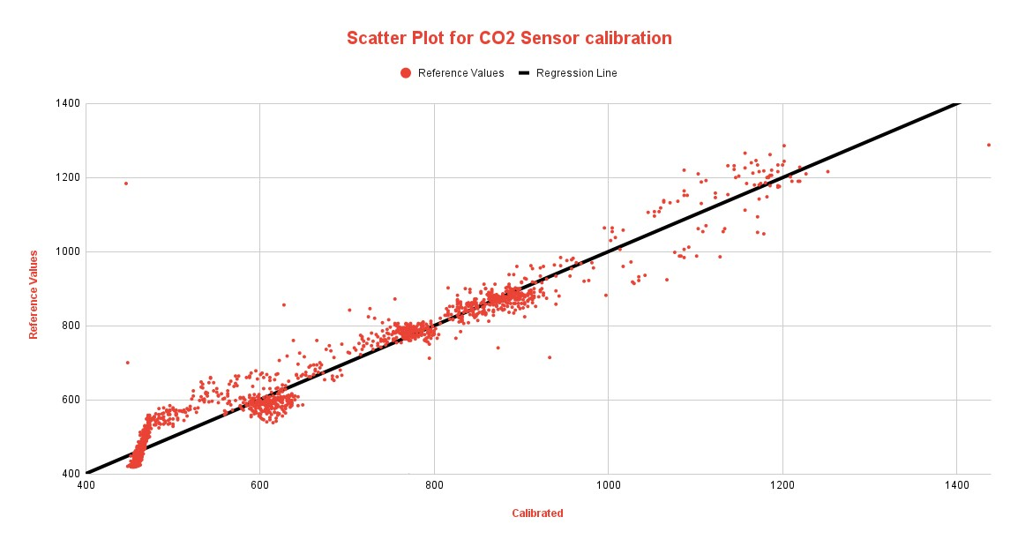
Scatter Plot

Slide 13

Features of Dashboard
Live
Displays the latest sensor-wise data with appropriate colour coding where GREEN, ORANGE and RED are used to show values that are in safe, moderate and hazardous levels respectively
Alerts
Users subscribe to E-mail alerts to get notified when air pollutants rise to hazardous amounts
Graphs
Displays readings versus time
graphs for different air pollutants and also shows if the node is ONLINE or not

Slide 14
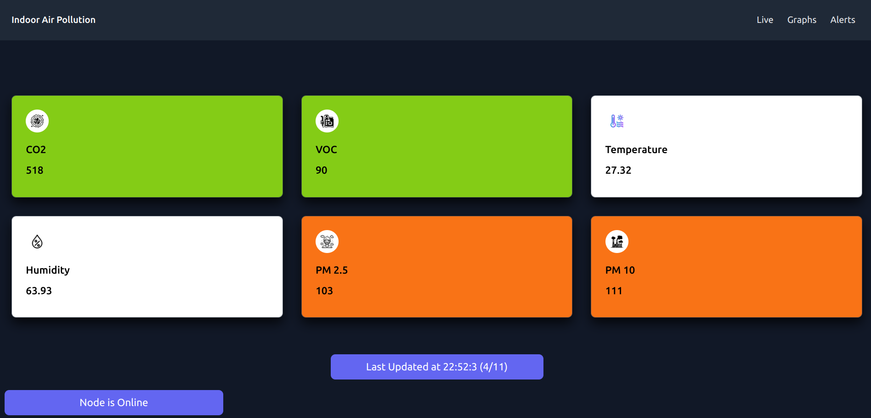
Dashboard UI

Slide 15
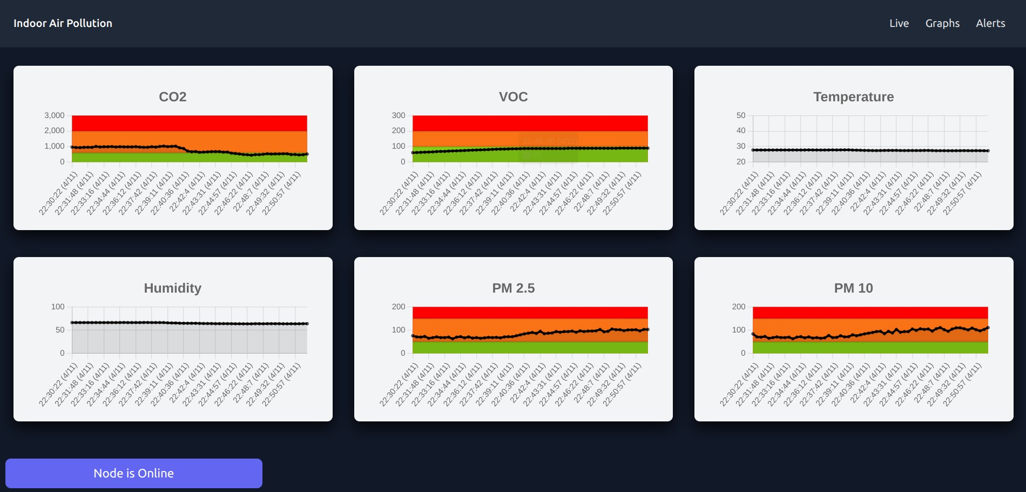
Dashboard UI

Slide 16

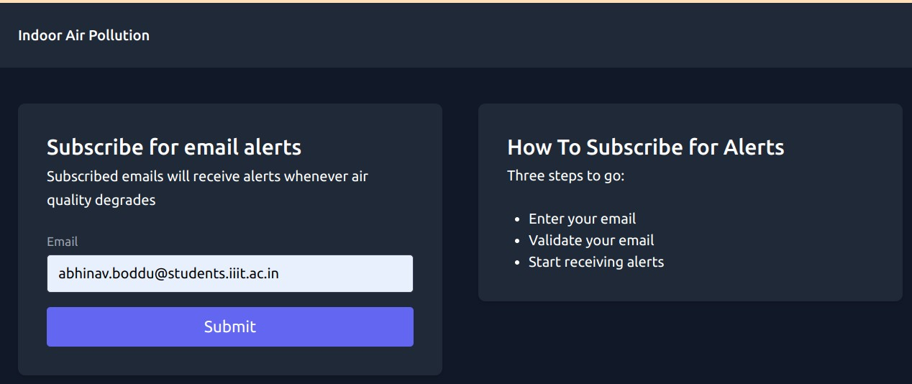
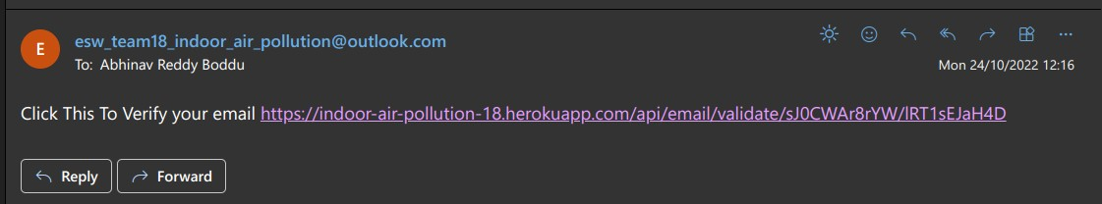
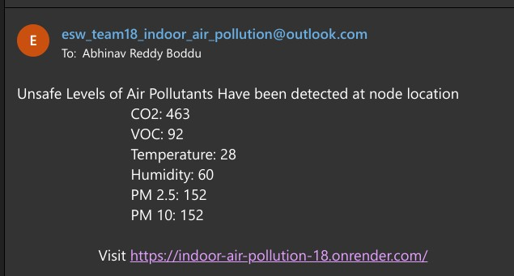
ALERT SYSTEM MECHANISM

Slide 17
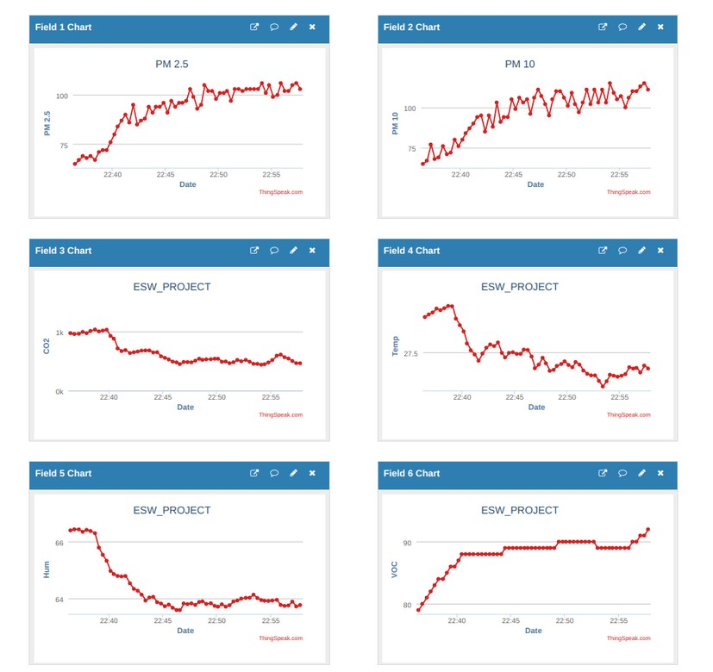
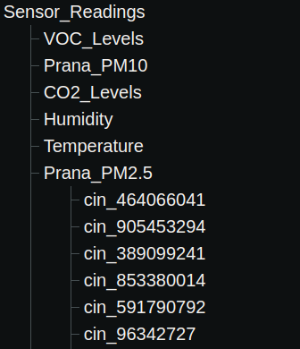
OM2M
ThingSpeak
Using "ThingSpeak.h" library functions and HTTP Requests through POST-API queries, we data is sent to ThingSpeak into 6 fields where: Field 1 - Particulate Matter 2.5
Field 2 - Particulate Matter 10 Field 3 - Carbon Dioxide
Field 4 - Volatile Organic Compounds Field 5 - Temperature
Field 6 - Humidity
Python script is used to create application entity and containers in OM2M and then data is sent through HTTP requests from the node as container instances which are posted into one of the following containers in the following format:
String cnt[] = {"Prana_PM2.5", "Prana_PM10", "CO2_Levels", "VOC_Levels", "Temperature", "Humidity"}

Slide 18










Softwares used

Slide 19





SUMMARY
Email alerts are sent when measured values cross permissible limits Users can access the dashboard via QR Code/URL from any location Our device with the collaboration of other smart IoT devices can form a Smart Home providing an access to easier life in every household Reports can be provided to users every month about the air quality based on the readings taken
Our device can aid in detecting locations that cause excessive harm to the environment.

Slide 20
WEEK 1
Brainstorming
Hardware prototyping Circuit interfacing on Zero PCB
WEEK 2
Microprocessor code ThingSpeak and OM2M integration
ACTION PLAN
GOING FORWARD
Ground deployment Management
WEEK 3
Dashboard
Alert mechanism
Interfacing PM sensor
WEEK 4
Calibration Analytics
Validation

Slide 21
DIVISION OF WORK
ABHINAV REDDY
DASHBOARD & CUSTOM SERVER
ROHIT GOWLAPALLI
HARDWARE & SENSOR CODE
GNANA PRAKASH
OM 2 M & THINGSPEAK CODE
LSA MOURYA
DATA ANALYSIS & REPORTS

